Slide 1

William Stallings Computer Organization and Architecture 9th Edition
Notes:
Lecture slides prepared for “Computer Organization and Architecture”, 9/e, by William Stallings, Chapter 8 “Operating System Support”.

Slide 2
Chapter 8
Operating System Support
Notes:
Although the focus of this text is computer hardware, there is one area of software
that needs to be addressed: the computer’s OS. The OS is a program that manages
the computer’s resources, provides services for programmers, and schedules the
execution of other programs. Some understanding of operating systems is essential
to appreciate the mechanisms by which the CPU controls the computer system. In
particular, explanations of the effect of interrupts and of the management of the
memory hierarchy are best explained in this context.
The chapter begins with an overview and brief history of operating systems.
The bulk of the chapter looks at the two OS functions that are most relevant to
the study of computer organization and architecture: scheduling and memory
management.

Slide 3
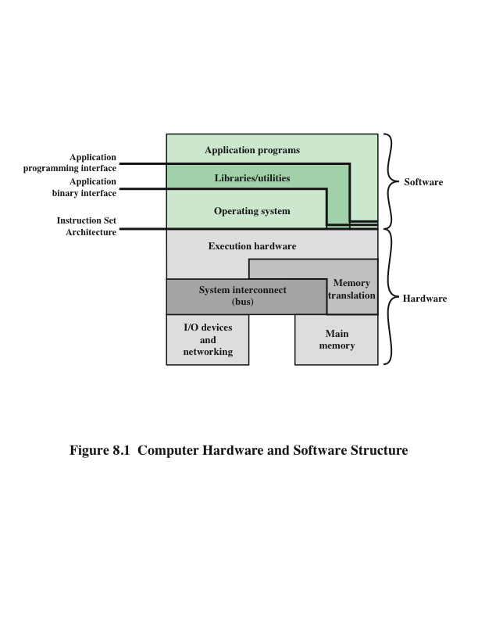
Computer Hardware and Software Structure
Notes:
An OS is a program that controls the execution of application programs and acts as
an interface between applications and the computer hardware. It can be thought of
as having two objectives:
• Convenience: An OS makes a computer more convenient to use.
• Efficiency: An OS allows the computer system resources to be used in an
efficient manner.
The hardware and software used in providing applications to a user can be viewed in a layered
or hierarchical fashion, as depicted in Figure 8.1. The user of those applications,
the end user, generally is not concerned with the computer’s architecture. Thus
the end user views a computer system in terms of an application. That application
can be expressed in a programming language and is developed by an application
programmer. To develop an application program as a set of processor instructions
that is completely responsible for controlling the computer hardware would be
an overwhelmingly complex task. To ease this task, a set of systems programs is
provided. Some of these programs are referred to as utilities. These implement
frequently used functions that assist in program creation, the management of
files, and the control of I/O devices. A programmer makes use of these facilities
in developing an application, and the application, while it is running, invokes the
utilities to perform certain functions.

Slide 4

Operating System (OS) Services
The most important system program
Masks the details of the hardware from the programmer and provides the programmer with a convenient interface for using the system
The OS typically provides services in the following areas:
Program creation
Program execution
Access to I/O devices
Controlled access to files
System access
Error detection and response
Accounting
Notes:
The most important system program is the OS.
The OS masks the details of the hardware from the programmer and provides the
programmer with a convenient interface for using the system. It acts as mediator,
making it easier for the programmer and for application programs to access and use
those facilities and services.
Briefly, the OS typically provides services in the following areas:
• Program creation: The OS provides a variety of facilities and services, such
as editors and debuggers, to assist the programmer in creating programs.
Typically, these services are in the form of utility programs that are not actually
part of the OS but are accessible through the OS.
• Program execution: A number of steps need to be performed to execute a
program. Instructions and data must be loaded into main memory, I/O devices
and files must be initialized, and other resources must be prepared. The OS
handles all of this for the user.
• Access to I/O devices: Each I/O device requires its own specific set of instructions
or control signals for operation. The OS takes care of the details so that
the programmer can think in terms of simple reads and writes.
• Controlled access to files: In the case of files, control must include an understanding
of not only the nature of the I/O device (disk drive, tape drive) but
also the file format on the storage medium. Again, the OS worries about the
details. Further, in the case of a system with multiple simultaneous users, the
OS can provide protection mechanisms to control access to the files.
• System access: In the case of a shared or public system, the OS controls access
to the system as a whole and to specific system resources. The access function
must provide protection of resources and data from unauthorized users and
must resolve conflicts for resource contention.
• Error detection and response: A variety of errors can occur while a computer
system is running. These include internal and external hardware errors, such as
a memory error, or a device failure or malfunction; and various software errors,
such as arithmetic overflow, attempt to access forbidden memory location, and
inability of the OS to grant the request of an application. In each case, the OS must
make the response that clears the error condition with the least impact on running
applications. The response may range from ending the program that caused the
error, to retrying the operation, to simply reporting the error to the application.
• Accounting: A good OS collects usage statistics for various resources and
monitor performance parameters such as response time. On any system, this
information is useful in anticipating the need for future enhancements and in
tuning the system to improve performance. On a multiuser system, the information
can be used for billing purposes.

Slide 5
Interfaces
Key interfaces in a typical computer system:
Instruction set architecture (ISA)
Defines the machine language instructions that a computer can follow
Boundary between hardware and software
Application binary interface (ABI)
Defines a standard for binary portability across programs
Defines the system call interface to the operating system and the hardware resources and services available in a system through the user ISA
Application programming interface (API)
Gives a program access to the hardware resources and services available in a system through the user ISA supplemented with high-level language (HLL) library calls
Using an API enables application software to be ported easily to other systems that support the same API
Notes:
Figure 8.1 also indicates three key interfaces in a typical computer system:
• Instruction set architecture (ISA): The ISA defines the repertoire of machine
language instructions that a computer can follow. This interface is the boundary
between hardware and software. Note that both application programs
and utilities may access the ISA directly. For these programs, a subset of the
instruction repertoire is available (user ISA). The OS has access to additional
machine language instructions that deal with managing system resources
(system ISA).
• Application binary interface (ABI): The ABI defines a standard for binary
portability across programs. The ABI defines the system call interface to the
operating system and the hardware resources and services available in a system
through the user ISA.
• Application programming interface (API): The API gives a program access
to the hardware resources and services available in a system through the user
ISA supplemented with high-level language (HLL) library calls. Any system
calls are usually performed through libraries. Using an API enables application
software to be ported easily, through recompilation, to other systems that
support the same API.

Slide 6
Operating System as Resource Manager
A computer is a set of resources for the movement, storage, and processing of data and for the control of these functions
The OS is responsible for managing these resources
The OS as a control mechanism is unusual in two respects:
The OS functions in the same way as ordinary computer software – it is a program executed by the processor
The OS frequently relinquishes control and must depend on the processor to allow it to regain control
Notes:
A computer is a set of resources for the movement, storage, and processing of data and for the control of
these functions. The OS is responsible for managing these resources.
Can we say that the OS controls the movement, storage, and processing of
data? From one point of view, the answer is yes: By managing the computer’s
resources, the OS is in control of the computer’s basic functions. But this control is
exercised in a curious way. Normally, we think of a control mechanism as something
external to that which is controlled, or at least as something that is a distinct and
separate part of that which is controlled. (For example, a residential heating system
is controlled by a thermostat, which is completely distinct from the heat-generation
and heat-distribution apparatus.) This is not the case with the OS, which as a control
mechanism is unusual in two respects:
• The OS functions in the same way as ordinary computer software; that is, it is
a program executed by the processor.
• The OS frequently relinquishes control and must depend on the processor to
allow it to regain control.
Like other computer programs, the OS provides instructions for the processor.
The key difference is in the intent of the program. The OS directs the processor
in the use of the other system resources and in the timing of its execution of other
programs. But in order for the processor to do any of these things, it must cease
executing the OS program and execute other programs. Thus, the OS relinquishes
control for the processor to do some “useful” work and then resumes control long
enough to prepare the processor to do the next piece of work. The mechanisms
involved in all this should become clear as the chapter proceeds.

Slide 7
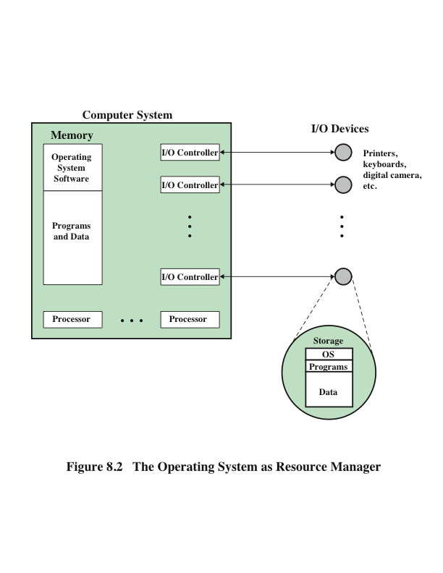
The OS as Resource Manager
Notes:
Figure 8.2 suggests the main resources that are managed by the OS. A portion
of the OS is in main memory. This includes the kernel, or nucleus, which contains
the most frequently used functions in the OS and, at a given time, other portions of
the OS currently in use. The remainder of main memory contains user programs and
data. The allocation of this resource (main memory) is controlled jointly by the OS
and memory-management hardware in the processor, as we shall see. The OS decides
when an I/O device can be used by a program in execution, and controls access to and
use of files. The processor itself is a resource, and the OS must determine how much
processor time is to be devoted to the execution of a particular user program. In the
case of a multiple-processor system, this decision must span all of the processors.

Slide 8
Types of Operating Systems
Interactive system
The user/programmer interacts directly with the computer to request the execution of a job or to perform a transaction
User may, depending on the nature of the application, communicate with the computer during the execution of the job
Batch system
Opposite of interactive
The user’s program is batched together with programs from other users and submitted by a computer operator
After the program is completed results are printed out for the user
Notes:
Certain key characteristics serve to differentiate various types of operating systems.
The characteristics fall along two independent dimensions. The first dimension
specifies whether the system is batch or interactive. In an interactive system, the
user/programmer interacts directly with the computer, usually through a keyboard/
display terminal, to request the execution of a job or to perform a transaction.
Furthermore, the user may, depending on the nature of the application, communicate
with the computer during the execution of the job. A batch system is the
opposite of interactive. The user’s program is batched together with programs from
other users and submitted by a computer operator. After the program is completed,
results are printed out for the user. Pure batch systems are rare today. However,
it will be useful to the description of contemporary operating systems to examine
batch systems briefly.
An independent dimension specifies whether the system employs multiprogramming
or not. With multiprogramming, the attempt is made to keep the processor
as busy as possible, by having it work on more than one program at a time. Several
programs are loaded into memory, and the processor switches rapidly among them.
The alternative is a uniprogramming system that works only one program at a time.

Slide 9
Early Systems
From the late 1940s to the mid-1950s the programmer interacted directly with the computer hardware – there was no OS
Processors were run from a console consisting of display lights, toggle switches, some form of input device and a printer
Problems:
Scheduling
Sign-up sheets were used to reserve processor time
This could result in wasted computer idle time if the user finished early
If problems occurred the user could be forced to stop before resolving the problem
Setup time
A single program could involve
Loading the compiler plus the source program into memory
Saving the compiled program
Loading and linking together the object program and common functions
Notes:
With the earliest computers, from the late 1940s to the mid-1950s,
the programmer interacted directly with the computer hardware; there was no
OS. These processors were run from a console, consisting of display lights, toggle
switches, some form of input device, and a printer. Programs in processor code were
loaded via the input device (e.g., a card reader). If an error halted the program,
the error condition was indicated by the lights. The programmer could proceed
to examine registers and main memory to determine the cause of the error. If the
program proceeded to a normal completion, the output appeared on the printer.
These early systems presented two main problems:
• Scheduling: Most installations used a sign-up sheet to reserve processor time.
Typically, a user could sign up for a block of time in multiples of a half hour or
so. A user might sign up for an hour and finish in 45 minutes; this would result
in wasted computer idle time. On the other hand, the user might run into problems,
not finish in the allotted time, and be forced to stop before resolving
the problem.
• Setup time: A single program, called a job, could involve loading the compiler
plus the high-level language program (source program) into memory,
saving the compiled program (object program), and then loading and linking
together the object program and common functions. Each of these steps could
involve mounting or dismounting tapes, or setting up card decks. If an error
occurred, the hapless user typically had to go back to the beginning of the
setup sequence. Thus a considerable amount of time was spent just in setting
up the program to run.
This mode of operation could be termed serial processing, reflecting the fact
that users have access to the computer in series. Over time, various system software
tools were developed to attempt to make serial processing more efficient. These
include libraries of common functions, linkers, loaders, debuggers, and I/O driver
routines that were available as common software for all users.

Slide 10
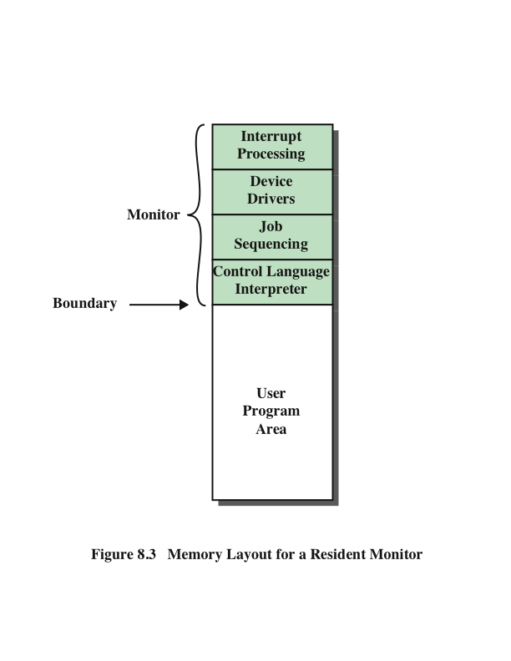
Memory Layout for a Resident Monitor
Notes:
Early processors were very expensive, and therefore it
was important to maximize processor utilization. The wasted time due to scheduling
and setup time was unacceptable.
To improve utilization, simple batch operating systems were developed. With
such a system, also called a monitor, the user no longer has direct access to the
processor. Rather, the user submits the job on cards or tape to a computer operator,
who batches the jobs together sequentially and places the entire batch on an input
device, for use by the monitor.
To understand how this scheme works, let us look at it from two points of
view: that of the monitor and that of the processor. From the point of view of the
monitor, the monitor controls the sequence of events. For this to be so, much of the
monitor must always be in main memory and available for execution (Figure 8.3).
That portion is referred to as the resident monitor. The rest of the monitor consists
of utilities and common functions that are loaded as subroutines to the user program
at the beginning of any job that requires them. The monitor reads in jobs one
at a time from the input device (typically a card reader or magnetic tape drive). As it
is read in, the current job is placed in the user program area, and control is passed to
this job. When the job is completed, it returns control to the monitor, which immediately
reads in the next job. The results of each job are printed out for delivery to
the user.

Slide 11
From the View of the Processor . . .
Processor executes instructions from the portion of main memory containing the monitor
These instructions cause the next job to be read in another portion of main memory
The processor executes the instruction in the user’s program until it encounters an ending or error condition
Either event causes the processor to fetch its next instruction from the monitor program
The monitor handles setup and scheduling
A batch of jobs is queued up and executed as rapidly as possible with no idle time
Job control language (JCL)
Special type of programming language used to provide instructions to the monitor
Example:
$JOB
$FTN
... Some Fortran instructions
$LOAD
$RUN
... Some data
$END
Monitor, or batch OS, is simply a computer program
It relies on the ability of the processor to fetch instructions from various portions of main memory in order to seize and relinquish control alternately
**Each FORTRAN instruction and each item of
data is on a separate punched card or a separate record on tape. In addition to FORTRAN and data lines, the job includes job control instructions, which are
denoted by the beginning “$”.
Notes:
Now consider this sequence from the point of view of the processor. At a certain
point in time, the processor is executing instructions from the portion of main
memory containing the monitor. These instructions cause the next job to be read
in to another portion of main memory. Once a job has been read in, the processor
will encounter in the monitor a branch instruction that instructs the processor to
continue execution at the start of the user program. The processor will then execute
the instruction in the user’s program until it encounters an ending or error condition.
Either event causes the processor to fetch its next instruction from the monitor
program. Thus the phrase “control is passed to a job” simply means that the processor
is now fetching and executing instructions in a user program, and “control is
returned to the monitor” means that the processor is now fetching and executing
instructions from the monitor program.
It should be clear that the monitor handles the scheduling problem. A batch of
jobs is queued up, and jobs are executed as rapidly as possible, with no intervening
idle time.
How about the job setup time? The monitor handles this as well. With each
job, instructions are included in a job control language (JCL). This is a special type
of programming language used to provide instructions to the monitor. A simple
example is that of a user submitting a program written in FORTRAN plus some
data to be used by the program. Each FORTRAN instruction and each item of
data is on a separate punched card or a separate record on tape. In addition to
FORTRAN and data lines, the job includes job control instructions, which are
denoted by the beginning “$”.
To execute this job, the monitor reads the $FTN line and loads the appropriate
compiler from its mass storage (usually tape). The compiler translates the user’s
program into object code, which is stored in memory or mass storage. If it is stored
in memory, the operation is referred to as “compile, load, and go.” If it is stored
on tape, then the $LOAD instruction is required. This instruction is read by the
monitor, which regains control after the compile operation. The monitor invokes
the loader, which loads the object program into memory in place of the compiler
and transfers control to it. In this manner, a large segment of main memory can
be shared among different subsystems, although only one such subsystem could be
resident and executing at a time.
We see that the monitor, or batch OS, is simply a computer program. It relies
on the ability of the processor to fetch instructions from various portions of main
memory in order to seize and relinquish control alternately.

Slide 12
Desirable Hardware Features
Memory protection
User program must not alter the memory area containing the monitor
The processor hardware should detect an error and transfer control to the monitor
The monitor aborts the job, prints an error message, and loads the next job
Privileged instructions
Can only be executed by the monitor
If the processor encounters such an instruction while executing a user program an error interrupt occurs
I/O instructions are privileged so the monitor retains control of all I/O devices
Timer
Used to prevent a job from monopolizing the system
If the timer expires an interrupt occurs and control returns to monitor
Interrupts
Gives the OS more flexibility in relinquishing control to and regaining control from user programs
Notes:
Certain other hardware features are also desirable:
• Memory protection: While the user program is executing, it must not alter the
memory area containing the monitor. If such an attempt is made, the processor
hardware should detect an error and transfer control to the monitor. The
monitor would then abort the job, print out an error message, and load the
next job.
• Timer: A timer is used to prevent a single job from monopolizing the system.
The timer is set at the beginning of each job. If the timer expires, an interrupt
occurs, and control returns to the monitor.
• Privileged instructions: Certain instructions are designated privileged and can
be executed only by the monitor. If the processor encounters such an instruction
while executing a user program, an error interrupt occurs. Among the
privileged instructions are I/O instructions, so that the monitor retains control
of all I/O devices. This prevents, for example, a user program from accidentally
reading job control instructions from the next job. If a user program
wishes to perform I/O, it must request that the monitor perform the operation
for it. If a privileged instruction is encountered by the processor while it is
executing a user program, the processor hardware considers this an error and
transfers control to the monitor.
• Interrupts: Early computer models did not have this capability. This feature
gives the OS more flexibility in relinquishing control to and regaining control
from user programs.
Processor time alternates between execution of user programs and execution
of the monitor. There have been two sacrifices: Some main memory is now given
over to the monitor and some processor time is consumed by the monitor. Both
of these are forms of overhead. Even with this overhead, the simple batch system
improves utilization of the computer.

Slide 13
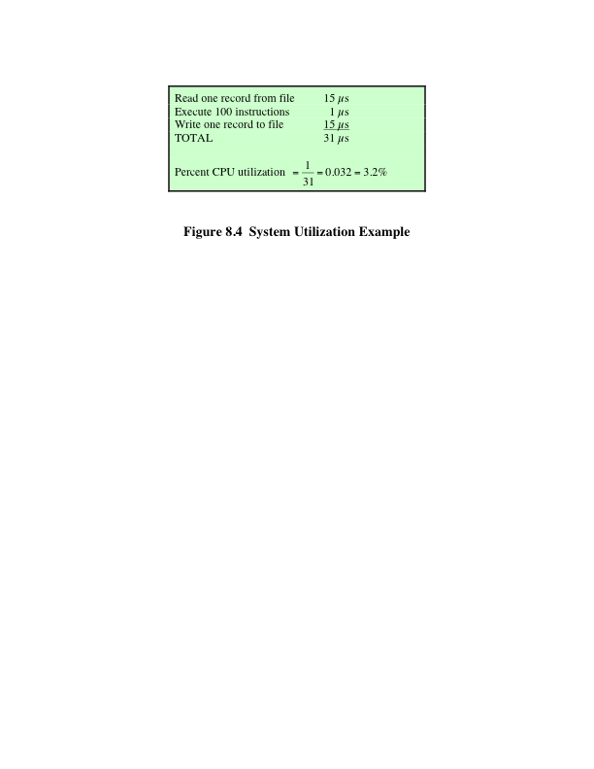
System Utilization Example
Notes:
Even with the automatic job sequencing
provided by a simple batch OS, the processor is often idle. The problem is that
I/O devices are slow compared to the processor. Figure 8.4 details a representative
calculation. The calculation concerns a program that processes a file of records and
performs, on average, 100 processor instructions per record. In this example the
computer spends over 96% of its time waiting for I/O devices to finish transferring
data! Figure 8.5a illustrates this situation.

Slide 14
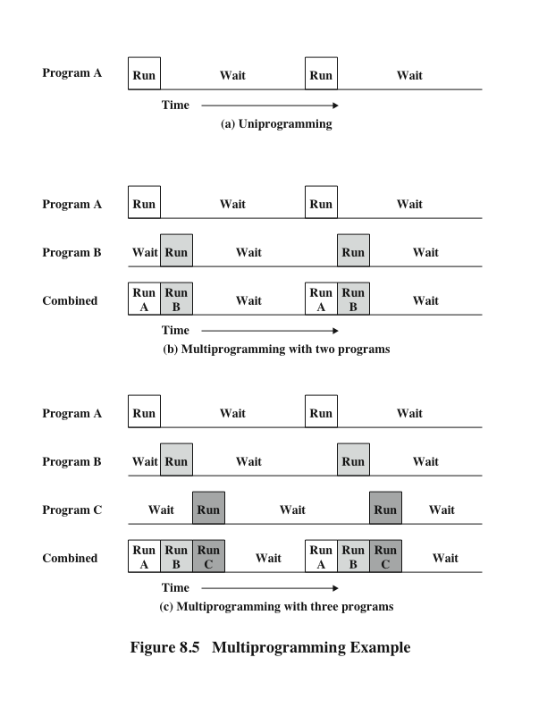
Multiprogramming Example
Notes:
The processor spends a certain amount of time executing, until it reaches an I/O instruction. It must then wait until that I/O
instruction concludes before proceeding.
This inefficiency is not necessary. We know that there must be enough memory
to hold the OS (resident monitor) and one user program. Suppose that there
is room for the OS and two user programs. Now, when one job needs to wait for
I/O, the processor can switch to the other job, which likely is not waiting for I/O
(Figure 8.5b). Furthermore, we might expand memory to hold three, four, or more
programs and switch among all of them (Figure 8.5c). This technique is known as multiprogramming,
or multitasking. It is the central theme of modern operating systems.
As with a simple batch system, a multiprogramming batch system must rely
on certain computer hardware features. The most notable additional feature that
is useful for multiprogramming is the hardware that supports I/O interrupts and
DMA. With interrupt-driven I/O or DMA, the processor can issue an I/O command
for one job and proceed with the execution of another job while the I/O is carried
out by the device controller. When the I/O operation is complete, the processor is
interrupted and control is passed to an interrupt-handling program in the OS. The
OS will then pass control to another job.

Slide 15
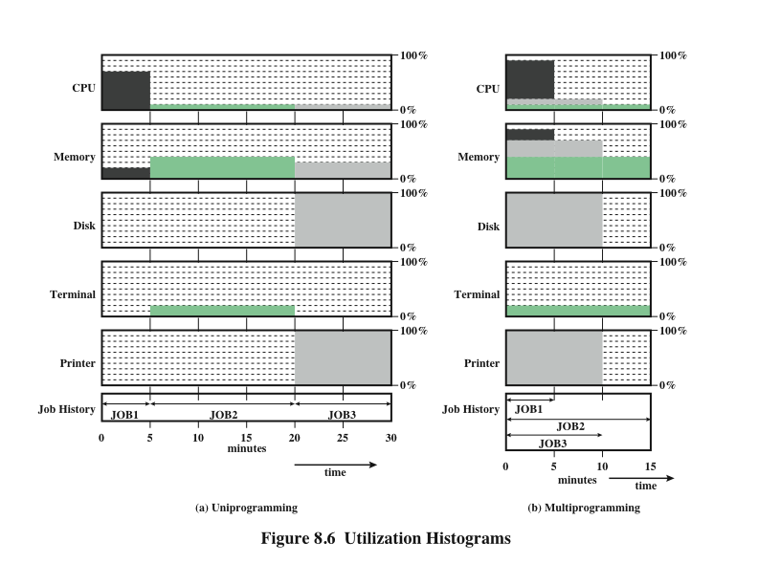
Notes:
Multiprogramming operating systems are fairly sophisticated compared to
single-program, or uniprogramming, systems. To have several jobs ready to run, the
jobs must be kept in main memory, requiring some form of memory management.
In addition, if several jobs are ready to run, the processor must decide which one
to run, which requires some algorithm for scheduling. These concepts are discussed
later in this chapter.

Slide 16
Time Sharing Systems
Used when the user interacts directly with the computer
Processor’s time is shared among multiple users
Multiple users simultaneously access the system through terminals, with the OS interleaving the execution of each user program in a short burst or quantum of computation
Example:
If there are n users actively requesting service at one time, each user will only see on the average 1/n of the effective computer speed
Notes:
With the use of multiprogramming, batch processing
can be quite efficient. However, for many jobs, it is desirable to provide a mode in
which the user interacts directly with the computer. Indeed, for some jobs, such as
transaction processing, an interactive mode is essential.
Today, the requirement for an interactive computing facility can be, and often
is, met by the use of a dedicated microcomputer. That option was not available in the
1960s, when most computers were big and costly. Instead, time sharing was developed.
Just as multiprogramming allows the processor to handle multiple batch jobs
at a time, multiprogramming can be used to handle multiple interactive jobs. In
this latter case, the technique is referred to as time sharing, because the processor’s
time is shared among multiple users. In a time-sharing system, multiple users
simultaneously access the system through terminals, with the OS interleaving the
execution of each user program in a short burst or quantum of computation. Thus,
if there are n users actively requesting service at one time, each user will only see
on the average 1/n of the effective computer speed, not counting OS overhead.
However, given the relatively slow human reaction time, the response time on a
properly designed system should be comparable to that on a dedicated computer.

Slide 17
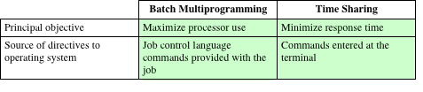
Batch
Multiprogramming
versus
Time Sharing
Notes:
Both batch multiprogramming and time sharing use multiprogramming. The
key differences are listed in Table 8.3.

Slide 18
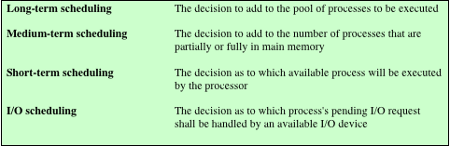
Scheduling
The key to multiprogramming
Four types are typically involved:
Table 8.4 Types of Scheduling
Notes:
The key to multiprogramming is scheduling. In fact, four types of scheduling are
typically involved (Table 8.4). We will explore these presently. But first, we introduce
the concept of process. This term was first used by the designers of the Multics
OS in the 1960s. It is a somewhat more general term than job. Many definitions
have been given for the term process, including
• A program in execution
• The “animated spirit” of a program
• That entity to which a processor is assigned

Slide 19
Long Term Scheduling
Determines which programs are submitted for processing
Once submitted, a job becomes a process for the short term scheduler
In some systems a newly created process begins in a swapped-out condition, in which case it is added to a queue for the medium-term scheduler
Batch system
Newly submitted jobs are routed to disk and held in a batch queue
The long-term scheduler creates processes from the queue when it can
Time-sharing system
A process request is generated when a user attempts to connect to the system
OS will accept all authorized comers until the system is saturated
At that point a connection request is met with a message indicating that the system is full and to try again later
Notes:
The long-term scheduler determines which programs are admitted to the system for
processing. Thus, it controls the degree of multiprogramming (number of processes
in memory). Once admitted, a job or user program becomes a process and is
added to the queue for the short-term scheduler. In some systems, a newly created
process begins in a swapped-out condition, in which case it is added to a queue for
the medium-term scheduler.
In a batch system, or for the batch portion of a general-purpose OS, newly
submitted jobs are routed to disk and held in a batch queue. The long-term scheduler
creates processes from the queue when it can. There are two decisions involved
here. First, the scheduler must decide that the OS can take on one or more additional
processes. Second, the scheduler must decide which job or jobs to accept and
turn into processes. The criteria used may include priority, expected execution time,
and I/O requirements.
For interactive programs in a time-sharing system, a process request is generated
when a user attempts to connect to the system. Time-sharing users are not
simply queued up and kept waiting until the system can accept them. Rather, the
OS will accept all authorized comers until the system is saturated, using some predefined
measure of saturation. At that point, a connection request is met with a
message indicating that the system is full and the user should try again later.

Slide 20
Medium-Term Scheduling and Short-Term Scheduling
Medium-Term
Short-Term
Part of the swapping function
Swapping-in decision is based on the need to manage the degree of multiprogramming
Swapping-in decision will consider the memory requirements of the swapped-out processes
Also known as the dispatcher
Executes frequently and makes the fine-grained decision of which job to execute next
Notes:
Medium-term scheduling is part of the swapping function, described in Section 8.3.
Typically, the swapping-in decision is based on the need to manage the degree of
multiprogramming. On a system that does not use virtual memory, memory management
is also an issue. Thus, the swapping-in decision will consider the memory
requirements of the swapped-out processes.
The long-term scheduler executes relatively infrequently and makes the coarse grained
decision of whether or not to take on a new process, and which one to take.
The short-term scheduler, also known as the dispatcher, executes frequently and
makes the fine-grained decision of which job to execute next.

Slide 21
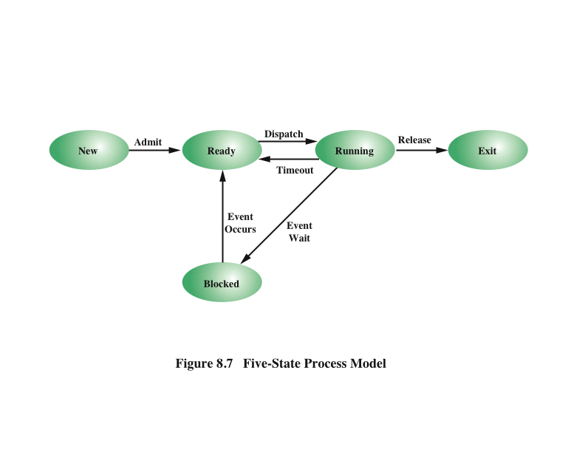
Five State Process Model
Notes:
To understand the operation of the short-term scheduler, we
need to consider the concept of a process state. During the lifetime of a process,
its status will change a number of times. Its status at any point in time is referred to
as a state. The term state is used because it connotes that certain information exists
that defines the status at that point. At minimum, there are five defined states for a
process (Figure 8.7):
• New: A program is admitted by the high-level scheduler but is not yet ready
to execute. The OS will initialize the process, moving it to the ready state.
• Ready: The process is ready to execute and is awaiting access to the processor.
• Running: The process is being executed by the processor.
• Waiting: The process is suspended from execution waiting for some system
resource, such as I/O.
• Halted: The process has terminated and will be destroyed by the OS.

Slide 22
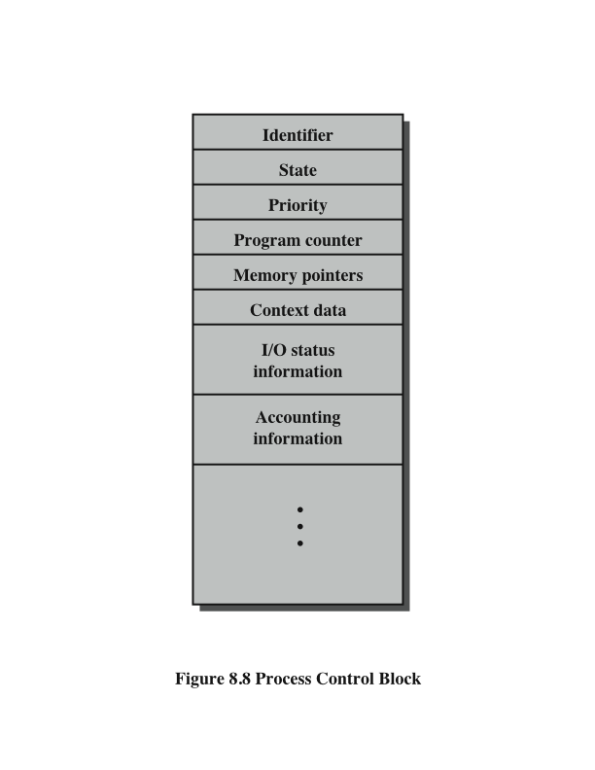
Process Control Block
Notes:
For each process in the system, the OS must maintain information indicating
the state of the process and other information necessary for process execution.
For this purpose, each process is represented in the OS by a process control block
(Figure 8.8), which typically contains
• Identifier: Each current process has a unique identifier.
• State: The current state of the process (new, ready, and so on).
• Priority: Relative priority level.
• Program counter: The address of the next instruction in the program to be
executed.
• Memory pointers: The starting and ending locations of the process in memory.
• Context data: These are data that are present in registers in the processor
while the process is executing, and they will be discussed in Part Three. For
now, it is enough to say that these data represent the “context” of the process.
The context data plus the program counter are saved when the process leaves
the running state. They are retrieved by the processor when it resumes execution
of the process.
• I/O status information: Includes outstanding I/O requests, I/O devices (e.g., tape
drives) assigned to this process, a list of files assigned to the process, and so on.
• Accounting information: May include the amount of processor time and clock
time used, time limits, account numbers, and so on.
When the scheduler accepts a new job or user request for execution, it creates
a blank process control block and places the associated process in the new state.
After the system has properly filled in the process control block, the process is
transferred to the ready state.

Slide 23
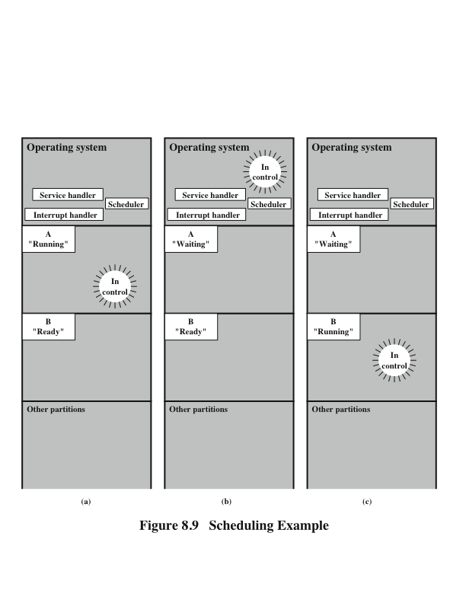
Scheduling Example
Notes:
To understand how the OS manages the scheduling of the
various jobs in memory, let us begin by considering the simple example in Figure 8.9.
The figure shows how main memory is partitioned at a given point in time. The
kernel of the OS is, of course, always resident. In addition, there are a number of
active processes, including A and B, each of which is allocated a portion of memory.
We begin at a point in time when process A is running. The processor is executing
instructions from the program contained in A’s memory partition. At some
later point in time, the processor ceases to execute instructions in A and begins
executing instructions in the OS area. This will happen for one of three reasons:
1. Process A issues a service call (e.g., an I/O request) to the OS. Execution of A
is suspended until this call is satisfied by the OS.
2. Process A causes an interrupt. An interrupt is a hardware-generated signal to
the processor. When this signal is detected, the processor ceases to execute A
and transfers to the interrupt handler in the OS. A variety of events related
to A will cause an interrupt. One example is an error, such as attempting to
execute a privileged instruction. Another example is a timeout; to prevent any
one process from monopolizing the processor, each process is only granted the
processor for a short period at a time.
3. Some event unrelated to process A that requires attention causes an interrupt.
An example is the completion of an I/O operation.
In any case, the result is the following. The processor saves the current context
data and the program counter for A in A’s process control block and then begins
executing in the OS. The OS may perform some work, such as initiating an I/O
operation. Then the short-term-scheduler portion of the OS decides which process
should be executed next. In this example, B is chosen. The OS instructs the processor
to restore B’s context data and proceed with the execution of B where it left off.

Slide 24
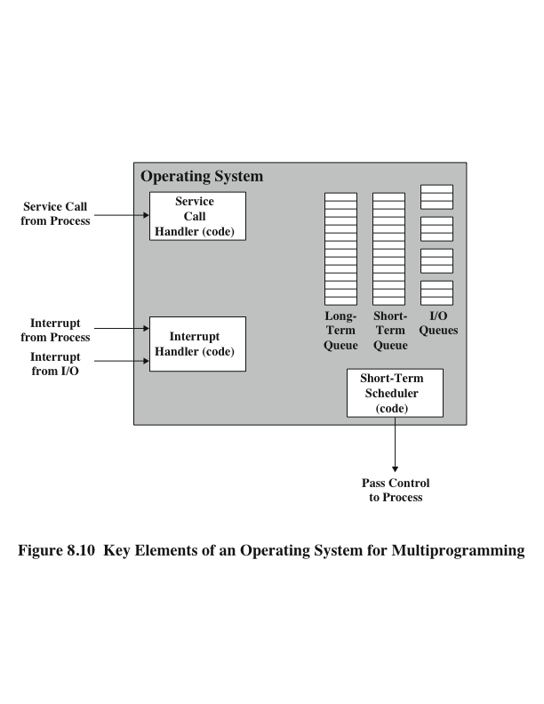
Key Elements of O/S
Notes:
This simple example highlights the basic functioning of the short-term scheduler.
Figure 8.10 shows the major elements of the OS involved in the multiprogramming
and scheduling of processes. The OS receives control of the processor at the
interrupt handler if an interrupt occurs and at the service-call handler if a service
call occurs. Once the interrupt or service call is handled, the short-term scheduler is
invoked to select a process for execution.
To do its job, the OS maintains a number of queues. Each queue is simply a
waiting list of processes waiting for some resource. The long-term queue is a list of
jobs waiting to use the system. As conditions permit, the high-level scheduler will
allocate memory and create a process for one of the waiting items. The short-term
queue consists of all processes in the ready state. Any one of these processes could
use the processor next. It is up to the short-term scheduler to pick one. Generally,
this is done with a round-robin algorithm, giving each process some time in turn.
Priority levels may also be used. Finally, there is an I/O queue for each I/O device.
More than one process may request the use of the same I/O device. All processes
waiting to use each device are lined up in that device’s queue.

Slide 25
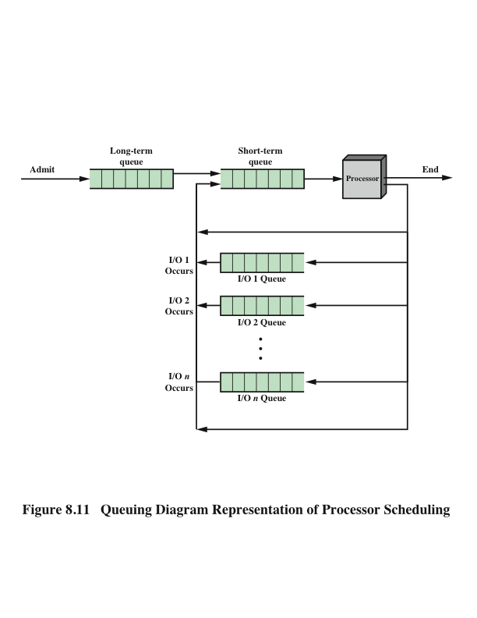
Process Scheduling
Notes:
Figure 8.11 suggests how processes progress through the computer under the
control of the OS. Each process request (batch job, user-defined interactive job) is
placed in the long-term queue. As resources become available, a process request
becomes a process and is then placed in the ready state and put in the short-term
queue. The processor alternates between executing OS instructions and executing
user processes. While the OS is in control, it decides which process in the short-term
queue should be executed next. When the OS has finished its immediate tasks, it
turns the processor over to the chosen process.
As was mentioned earlier, a process being executed may be suspended for
a variety of reasons. If it is suspended because the process requests I/O, then it
is placed in the appropriate I/O queue. If it is suspended because of a timeout or
because the OS must attend to pressing business, then it is placed in the ready state
and put into the short-term queue.
Finally, we mention that the OS also manages the I/O queues. When an I/O
operation is completed, the OS removes the satisfied process from that I/O queue
and places it in the short-term queue. It then selects another waiting process (if any)
and signals for the I/O device to satisfy that process’s request.

Slide 26
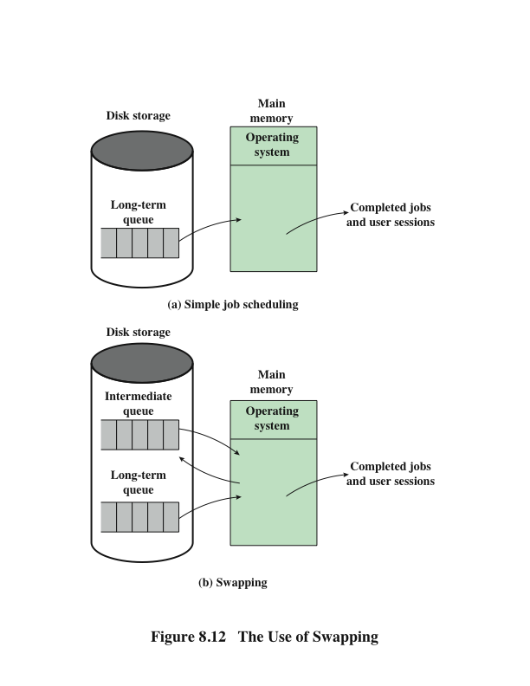
Memory Management
Swapping
Notes:
Main memory could be expanded, and so be able to accommodate
more processes. But there are two flaws in this approach. First, main memory
is expensive, even today. Second, the appetite of programs for memory has grown
as fast as the cost of memory has dropped. So larger memory results in larger processes,
not more processes.
Another solution is swapping, depicted in Figure 8.12. We have a long-term
queue of process requests, typically stored on disk. These are brought in, one at a
time, as space becomes available. As processes are completed, they are moved out
of main memory. Now the situation will arise that none of the processes in memory
are in the ready state (e.g., all are waiting on an I/O operation). Rather than remain
idle, the processor swaps one of these processes back out to disk into an intermediate
queue. This is a queue of existing processes that have been temporarily kicked out
of memory. The OS then brings in another process from the intermediate queue, or
it honors a new process request from the long-term queue. Execution then continues
with the newly arrived process.
Swapping, however, is an I/O operation, and therefore there is the potential
for making the problem worse, not better. But because disk I/O is generally the
fastest I/O on a system (e.g., compared with tape or printer I/O), swapping will usually
enhance performance. A more sophisticated scheme, involving virtual memory,
improves performance over simple swapping. This will be discussed shortly. But
first, we must prepare the ground by explaining partitioning and paging.

Slide 27
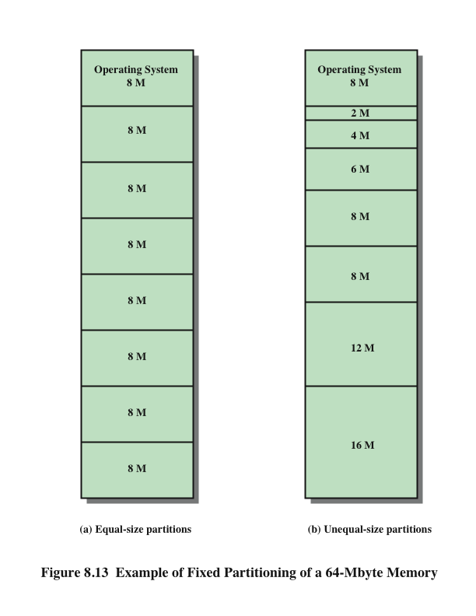
Memory Management
Partitioning
Notes:
The simplest scheme for partitioning available memory is to use fixed-size partitions,
as shown in Figure 8.13. Note that, although the partitions are of fixed size,
they need not be of equal size. When a process is brought into memory, it is placed
in the smallest available partition that will hold it.
Even with the use of unequal fixed-size partitions, there will be wasted memory.
In most cases, a process will not require exactly as much memory as provided by the
partition. For example, a process that requires 3M bytes of memory would be placed
in the 4M partition of Figure 8.13b, wasting 1M that could be used by another process.
A more efficient approach is to use variable-size partitions. When a process is
brought into memory, it is allocated exactly as much memory as it requires and no more.

Slide 28
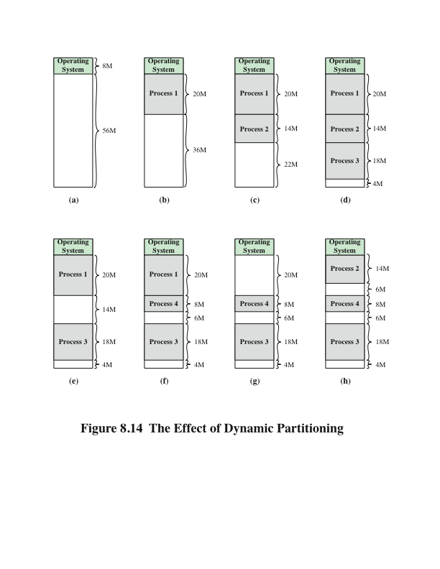
Effect of Dynamic Partitioning
Logical address
- expressed as a location relative to the
beginning of the program
Physical address
- an actual location in main memory
Base address
- current starting location of the process
Notes:
Before we consider ways of dealing with the shortcomings of partitioning, we
must clear up one loose end. Consider Figure 8.14; it should be obvious that a process
is not likely to be loaded into the same place in main memory each time it is
swapped in. Furthermore, if compaction is used, a process may be shifted while in
main memory. A process in memory consists of instructions plus data. The instructions
will contain addresses for memory locations of two types:
• Addresses of data items
• Addresses of instructions, used for branching instructions
But these addresses are not fixed. They will change each time a process is
swapped in. To solve this problem, a distinction is made between logical addresses
and physical addresses. A logical address is expressed as a location relative to the
beginning of the program. Instructions in the program contain only logical addresses.
A physical address is an actual location in main memory. When the processor executes
a process, it automatically converts from logical to physical address by adding
the current starting location of the process, called its base address, to each logical
address. This is another example of a processor hardware feature designed to meet
an OS requirement. The exact nature of this hardware feature depends on the memory
management strategy in use. We will see several examples later in this chapter.

Slide 29
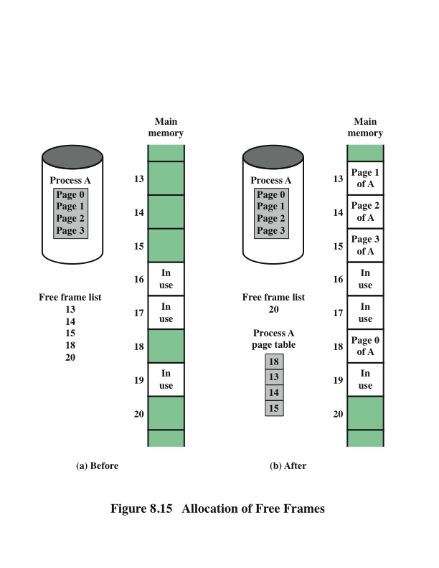
Memory Management
Paging
Notes:
Both unequal fixed-size and variable-size partitions are inefficient in the use of
memory. Suppose, however, that memory is partitioned into equal fixed-size chunks
that are relatively small, and that each process is also divided into small fixed-size
chunks of some size. Then the chunks of a program, known as pages, could be
assigned to available chunks of memory, known as frames, or page frames. At most,
then, the wasted space in memory for that process is a fraction of the last page.
Figure 8.15 shows an example of the use of pages and frames. At a given point
in time, some of the frames in memory are in use and some are free. The list of free
frames is maintained by the OS. Process A, stored on disk, consists of four pages.
When it comes time to load this process, the OS finds four free frames and loads the
four pages of the process A into the four frames.

Slide 30
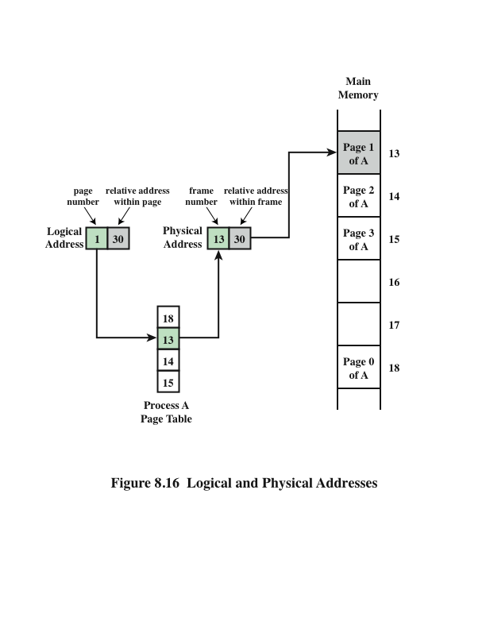
Logical and Physical Addresses Paging
Notes:
Now suppose, as in this example, that there are not sufficient unused contiguous
frames to hold the process. Does this prevent the OS from loading A?
The answer is no, because we can once again use the concept of logical address. A
simple base address will no longer suffice. Rather, the OS maintains a page table
for each process. The page table shows the frame location for each page of the
process. Within the program, each logical address consists of a page number and
a relative address within the page. Recall that in the case of simple partitioning, a
logical address is the location of a word relative to the beginning of the program;
the processor translates that into a physical address. With paging, the logical-to-
physical address translation is still done by processor hardware. The processor
must know how to access the page table of the current process. Presented with a
logical address (page number, relative address), the processor uses the page table
to produce a physical address (frame number, relative address). An example is
shown in Figure 8.16.
This approach solves the problems raised earlier. Main memory is divided
into many small equal-size frames. Each process is divided into frame-size pages:
smaller processes require fewer pages, larger processes require more. When a
process is brought in, its pages are loaded into available frames, and a page table
is set up.

Slide 31
Virtual Memory
Demand Paging
Each page of a process is brought in only when it is needed
Principle of locality
When working with a large process execution may be confined to a small section of a program (subroutine)
It is better use of memory to load in just a few pages
If the program references data or branches to an instruction on a page not in main memory, a page fault is triggered which tells the OS to bring in the desired page
Advantages:
More processes can be maintained in memory
Time is saved because unused pages are not swapped in and out of memory
Disadvantages:
When one page is brought in, another page must be thrown out (page replacement)
If a page is thrown out just before it is about to be used the OS will have to go get the page again
Thrashing
When the processor spends most of its time swapping pages rather than executing instructions
Notes:
With the use of paging, truly effective multiprogramming
systems came into being. Furthermore, the simple tactic of breaking a process up
into pages led to the development of another important concept: virtual memory.
To understand virtual memory, we must add a refinement to the paging
scheme just discussed. That refinement is demand paging, which simply means that
each page of a process is brought in only when it is needed, that is, on demand.
Consider a large process, consisting of a long program plus a number of arrays
of data. Over any short period of time, execution may be confined to a small section
of the program (e.g., a subroutine), and perhaps only one or two arrays of data
are being used. This is the principle of locality, which we introduced in Appendix
4A. It would clearly be wasteful to load in dozens of pages for that process when
only a few pages will be used before the program is suspended. We can make better
use of memory by loading in just a few pages. Then, if the program branches
to an instruction on a page not in main memory, or if the program references data
on a page not in memory, a page fault is triggered. This tells the OS to bring in the
desired page.
Thus, at any one time, only a few pages of any given process are in memory,
and therefore more processes can be maintained in memory. Furthermore, time is
saved because unused pages are not swapped in and out of memory. However, the
OS must be clever about how it manages this scheme. When it brings one page in, it
must throw another page out; this is known as page replacement. If it throws out a
page just before it is about to be used, then it will just have to go get that page again
almost immediately. Too much of this leads to a condition known as thrashing: the
processor spends most of its time swapping pages rather than executing instructions.
The avoidance of thrashing was a major research area in the 1970s and led to a variety
of complex but effective algorithms. In essence, the OS tries to guess, based on
recent history, which pages are least likely to be used in the near future.
With demand paging, it is not necessary to load an entire process into main
memory. This fact has a remarkable consequence: It is possible for a process to be
larger than all of main memory. One of the most fundamental restrictions in programming
has been lifted. Without demand paging, a programmer must be acutely
aware of how much memory is available. If the program being written is too large,
the programmer must devise ways to structure the program into pieces that can
be loaded one at a time. With demand paging, that job is left to the OS and the
hardware. As far as the programmer is concerned, he or she is dealing with a huge
memory, the size associated with disk storage.
Because a process executes only in main memory, that memory is referred to
as real memory. But a programmer or user perceives a much larger memory—that
which is allocated on the disk. This latter is therefore referred to as virtual memory.
Virtual memory allows for very effective multiprogramming and relieves the user of
the unnecessarily tight constraints of main memory.

Slide 32
Inverted Page Table Structure
Notes:
The basic mechanism for reading a word from memory
involves the translation of a virtual, or logical, address, consisting of page number
and offset, into a physical address, consisting of frame number and offset, using a
page table. Because the page table is of variable length, depending on the size of the
process, we cannot expect to hold it in registers. Instead, it must be in main memory
to be accessed. Figure 8.16 suggests a hardware implementation of this scheme.
When a particular process is running, a register holds the starting address of the
page table for that process. The page number of a virtual address is used to index
that table and look up the corresponding frame number. This is combined with the
offset portion of the virtual address to produce the desired real address.
In most systems, there is one page table per process. But each process can
occupy huge amounts of virtual memory. For example, in the VAX architecture,
each process can have up to 2³¹ = 2 Gbytes of virtual memory. Using 2⁹ = 512-byte
pages, that means that as many as 2²² page table entries are required per process.
Clearly, the amount of memory devoted to page tables alone could be unacceptably
high. To overcome this problem, most virtual memory schemes store page tables in
virtual memory rather than real memory. This means that page tables are subject to
paging just as other pages are. When a process is running, at least a part of its page
table must be in main memory, including the page table entry of the currently executing
page. Some processors make use of a two-level scheme to organize large page
tables. In this scheme, there is a page directory, in which each entry points to a page
table. Thus, if the length of the page directory is X, and if the maximum length of a
page table is Y, then a process can consist of up to X * Y pages. Typically, the maximum
length of a page table is restricted to be equal to one page. We will see an example
of this two-level approach when we consider the Pentium II later in this chapter.

Slide 33
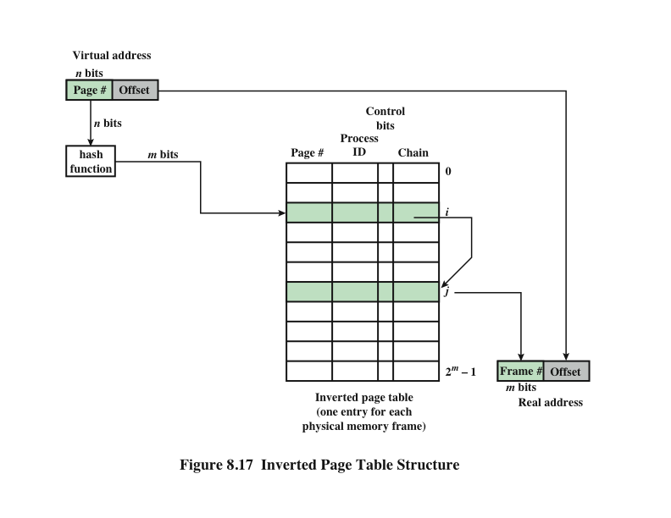
Inverted Page Table Structure
Notes:
An alternative approach to the use of one- or two-level page tables is the use
of an inverted page table structure (Figure 8.17). Variations on this approach are
used on the PowerPC, UltraSPARC, and the IA-64 architecture. An implementation
of the Mach OS on the RT-PC also uses this technique.
In this approach, the page number portion of a virtual address is mapped into
a hash value using a simple hashing function. The hash value is a pointer to the
inverted page table, which contains the page table entries. There is one entry in the
inverted page table for each real memory page frame rather than one per virtual
page. Thus a fixed proportion of real memory is required for the tables regardless of
the number of processes or virtual pages supported. Because more than one virtual
address may map into the same hash table entry, a chaining technique is used for
managing the overflow. The hashing technique results in chains that are typically
short—between one and two entries. The page table’s structure is called inverted
because it indexes page table entries by frame number rather than by virtual page
number.

Slide 34
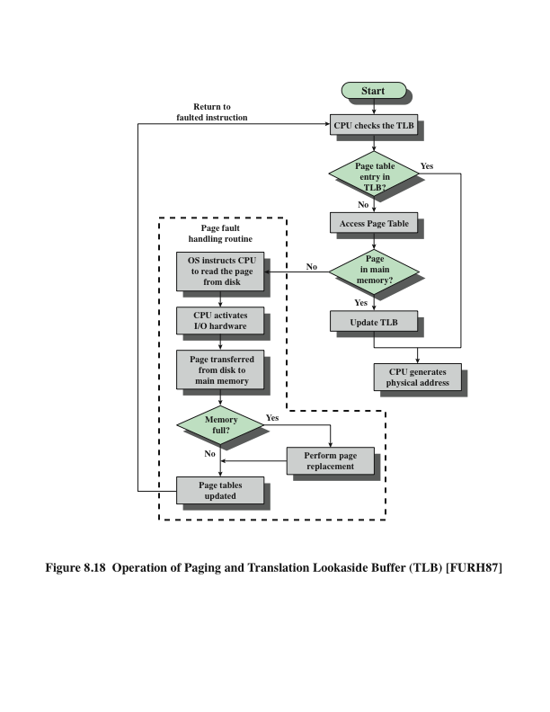
Operation of Paging and Translation Lookaside Buffer (TLB)
Notes:
In principle, then, every virtual memory reference can cause two physical memory
accesses: one to fetch the appropriate page table entry, and one to fetch the
desired data. Thus, a straightforward virtual memory scheme would have the effect
of doubling the memory access time. To overcome this problem, most virtual
memory schemes make use of a special cache for page table entries, usually called
a translation lookaside buffer (TLB). This cache functions in the same way as a
memory cache and contains those page table entries that have been most recently
used. Figure 8.18 is a flowchart that shows the use of the TLB. By the principle of
locality, most virtual memory references will be to locations in recently used pages.
Therefore, most references will involve page table entries in the cache. Studies of
the VAX TLB have shown that this scheme can significantly improve performance
[CLAR85, SATY81].

Slide 35
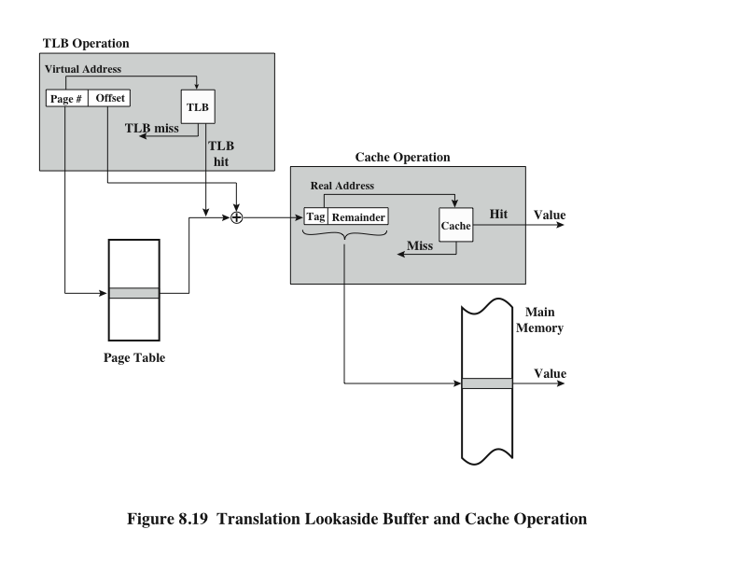
TLB and Cache Operation
Notes:
Note that the virtual memory mechanism must interact with the cache system
(not the TLB cache, but the main memory cache). This is illustrated in Figure 8.19.
A virtual address will generally be in the form of a page number, offset. First, the
memory system consults the TLB to see if the matching page table entry is present.
If it is, the real (physical) address is generated by combining the frame number with
the offset. If not, the entry is accessed from a page table. Once the real address is
generated, which is in the form of a tag and a remainder, the cache is consulted to
see if the block containing that word is present (see Figure 4.5). If so, it is returned
to the processor. If not, the word is retrieved from main memory.
The reader should be able to appreciate the complexity of the processor hardware
involved in a single memory reference. The virtual address is translated into
a real address. This involves reference to a page table, which may be in the TLB, in
main memory, or on disk. The referenced word may be in cache, in main memory,
or on disk. In the latter case, the page containing the word must be loaded into main
memory and its block loaded into the cache. In addition, the page table entry for
that page must be updated.

Slide 36


Segmentation
Usually visible to the programmer
Provided as a convenience for organizing programs and data and as a means for associating privilege and protection attributes with instructions and data
Allows the programmer to view memory as consisting of multiple address spaces or segments
Advantages:
Simplifies the handling of growing data structures
Allows programs to be altered and recompiled independently without requiring that an entire set of programs be re-linked and re-loaded
Lends itself to sharing among processes
Lends itself to protection
Notes:
There is another way in which addressable memory can be subdivided, known as
segmentation. Whereas paging is invisible to the programmer and serves the purpose
of providing the programmer with a larger address space, segmentation is usually
visible to the programmer and is provided as a convenience for organizing programs
and data and as a means for associating privilege and protection attributes with
instructions and data.
Segmentation allows the programmer to view memory as consisting of multiple
address spaces or segments. Segments are of variable, indeed dynamic, size.
Typically, the programmer or the OS will assign programs and data to different segments.
There may be a number of program segments for various types of programs as
well as a number of data segments. Each segment may be assigned access and usage
rights. Memory references consist of a (segment number, offset) form of address.
This organization has a number of advantages to the programmer over a non-segmented
address space:
1. It simplifies the handling of growing data structures. If the programmer does
not know ahead of time how large a particular data structure will become, it
is not necessary to guess. The data structure can be assigned its own segment,
and the OS will expand or shrink the segment as needed.
2. It allows programs to be altered and recompiled independently without
requiring that an entire set of programs be re-linked and reloaded. Again, this
is accomplished using multiple segments.
3. It lends itself to sharing among processes. A programmer can place a utility
program or a useful table of data in a segment that can be addressed by other
processes.
4. It lends itself to protection. Because a segment can be constructed to contain a
well-defined set of programs or data, the programmer or a system administrator
can assign access privileges in a convenient fashion.
These advantages are not available with paging, which is invisible to the programmer.
On the other hand, we have seen that paging provides for an efficient
form of memory management. To combine the advantages of both, some systems
are equipped with the hardware and OS software to provide both.

Slide 37
Hardware is essentially the same as that used in the Intel 80386 and 80486 processors
Includes hardware for both segmentation and paging
Unsegmented unpaged memory
Virtual address is the same as the physical address
Useful in low-complexity, high performance controller applications
Unsegmented paged memory
Memory is viewed as a paged linear address space
Protection and management of memory is done via paging
Favored by some operating systems
Segmented unpaged memory
Memory is viewed as a collection of logical address spaces
Affords protection down to the level of a single byte
Guarantees that the translation table needed is on-chip when the segment is in memory
Results in predictable access times
Segmented paged memory
Segmentation is used to define logical memory partitions subject to access control, and paging is used to manage the allocation of memory within the partitions
Operating systems such as UNIX System V favor this view
Pentium II
Memory
Management
Notes:
The Pentium II includes hardware for both segmentation and paging. Both mechanisms
can be disabled, allowing the user to choose from four distinct views of
memory:
• Unsegmented unpaged memory: In this case, the virtual address is the same
as the physical address. This is useful, for example, in low-complexity, high performance
controller applications.
• Unsegmented paged memory: Here memory is viewed as a paged linear
address space. Protection and management of memory is done via paging.
This is favored by some operating systems (e.g., Berkeley UNIX).
• Segmented unpaged memory: Here memory is viewed as a collection of logical
address spaces. The advantage of this view over a paged approach is that it
affords protection down to the level of a single byte, if necessary. Furthermore,
unlike paging, it guarantees that the translation table needed (the segment
table) is on-chip when the segment is in memory. Hence, segmented unpaged
memory results in predictable access times.
• Segmented paged memory: Segmentation is used to define logical memory
partitions subject to access control, and paging is used to manage the allocation
of memory within the partitions. Operating systems such as UNIX System V
favor this view.

Slide 38
Segmentation
Pentium II
Each virtual address consists of a 16-bit segment reference and a 32-bit offset
Two bits of segment reference deal with the protection mechanism
14 bits specify segment
Unsegmented virtual memory is 2³² = 4Gbytes
Segmented virtual memory is 2⁴⁶=64 terabytes (Tbytes)
Physical address space employs a 32-bit address for a maximum of 4 Gbytes
Virtual address space is divided into two parts
One-half is global, shared by all processors
The remainder is local and is distinct for each process
Notes:
When segmentation is used, each virtual address (called a logical address in the
Pentium II documentation) consists of a 16-bit segment reference and a 32-bit
offset. Two bits of the segment reference deal with the protection mechanism, leaving
14 bits for specifying a particular segment. Thus, with unsegmented memory, the
user’s virtual memory is 2³² = 4 Gbytes. With segmented memory, the total virtual
memory space as seen by a user is 2⁴⁶ = 64 terabytes (Tbytes). The physical address
space employs a 32-bit address for a maximum of 4 Gbytes.
The amount of virtual memory can actually be larger than the 64 Tbytes. This
is because the processor’s interpretation of a virtual address depends on which
process is currently active. Virtual address space is divided into two parts. One-half
of the virtual address space (8K segments * 4 Gbytes) is global, shared by all processes;
the remainder is local and is distinct for each process.

Slide 39
Segment Protection
Pentium II
Associated with each segment are two forms of protection:
Privilege level
Access attribute
There are four privilege levels
Most protected (level 0)
Least protected (level 3)
Privilege level associated with a data segment is its “classification”
Privilege level associated with a program segment is its “clearance”
An executing program may only access data segments for which its clearance level is lower than or equal to the privilege level of the data segment
The privilege mechanism also limits the use of certain instructions
Notes:
Associated with each segment are two forms of protection: privilege level and
access attribute. There are four privilege levels, from most protected (level 0) to
least protected (level 3). The privilege level associated with a data segment is its
“classification”; the privilege level associated with a program segment is its “clearance.”
An executing program may only access data segments for which its clearance
level is lower than (more privileged) or equal to (same privilege) the privilege level
of the data segment.
The hardware does not dictate how these privilege levels are to be used; this
depends on the OS design and implementation. It was intended that privilege level 1
would be used for most of the OS, and level 0 would be used for that small portion
of the OS devoted to memory management, protection, and access control.
This leaves two levels for applications. In many systems, applications will reside at
level 3, with level 2 being unused. Specialized application subsystems that must be
protected because they implement their own security mechanisms are good candidates
for level 2. Some examples are database management systems, office automation
systems, and software engineering environments.
In addition to regulating access to data segments, the privilege mechanism
limits the use of certain instructions. Some instructions, such as those dealing with
memory-management registers, can only be executed in level 0. I/O instructions can
only be executed up to a certain level that is designated by the OS; typically, this will
be level 1.
The access attribute of a data segment specifies whether read/write or read only
accesses are permitted. For program segments, the access attribute specifies
read/execute or read-only access.

Slide 40
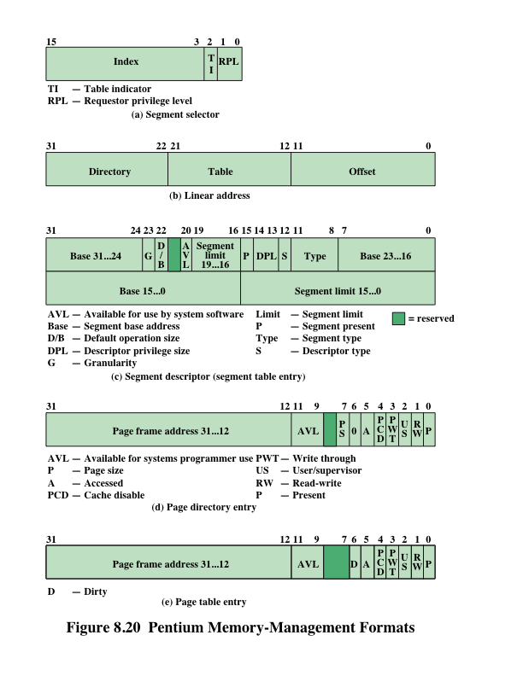
Pentium Memory Management Formats
Notes:
The address translation mechanism for segmentation involves mapping a virtual
address into what is referred to as a linear address (Figure 8.20b). A virtual
address consists of the 32-bit offset and a 16-bit segment selector (Figure 8.20a).
The segment selector consists of the following fields:
• Table Indicator (TI): Indicates whether the global segment table or a local
segment table should be used for translation.
• Segment Number: The number of the segment. This serves as an index into
the segment table.
• Requested Privilege Level (RPL): The privilege level requested for this access.

Slide 41
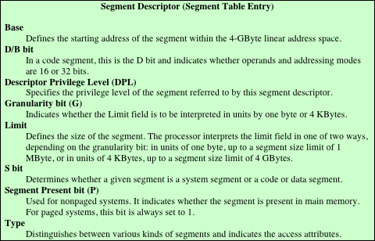
Table 8.5 Pentium II Memory Management Parameters (page 1 of 2)
Notes:
Each entry in a segment table consists of 64 bits, as shown in Figure 8.20c. The
fields are defined in Table 8.5.

Slide 42
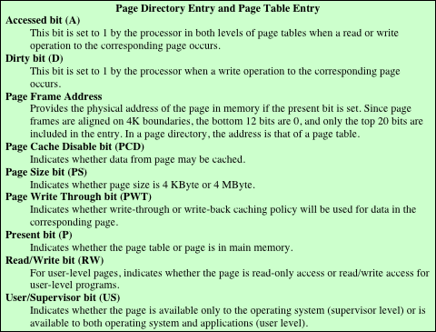
Table 8.5 Pentium II Memory Management Parameters (page 2 of 2)
Notes:
Pentium II memory management parameters – page 2 of 2

Slide 43
Paging
Pentium II
Segmentation may be disabled
In which case linear address space is used
Two level page table lookup
First, page directory
1024 entries max
Splits 4 Gbyte linear memory into 1024 page groups of 4 Mbyte
Each page table has 1024 entries corresponding to 4 Kbyte pages
Can use one page directory for all processes, one per process or mixture
Page directory for current process always in memory
Use TLB holding 32 page table entries
Two page sizes available, 4k or 4M
Notes:
Segmentation is an optional feature and may be disabled. When segmentation is in
use, addresses used in programs are virtual addresses and are converted into linear
addresses, as just described. When segmentation is not in use, linear addresses are
used in programs. In either case, the following step is to convert that linear address
into a real 32-bit address.
To understand the structure of the linear address, you need to know that
the Pentium II paging mechanism is actually a two-level table lookup operation.
The first level is a page directory, which contains up to 1024 entries. This splits the
4-Gbyte linear memory space into 1024 page groups, each with its own page table,
and each 4 Mbytes in length. Each page table contains up to 1024 entries; each entry
corresponds to a single 4-Kbyte page. Memory management has the option of using
one page directory for all processes, one page directory for each process, or some
combination of the two. The page directory for the current task is always in main
memory. Page tables may be in virtual memory.
Figure 8.20 shows the formats of entries in page directories and page tables,
and the fields are defined in Table 8.5. Note that access control mechanisms can be
provided on a page or page group basis.
The Pentium II also makes use of a translation lookaside buffer. The buffer
can hold 32 page table entries. Each time that the page directory is changed, the
buffer is cleared.

Slide 44
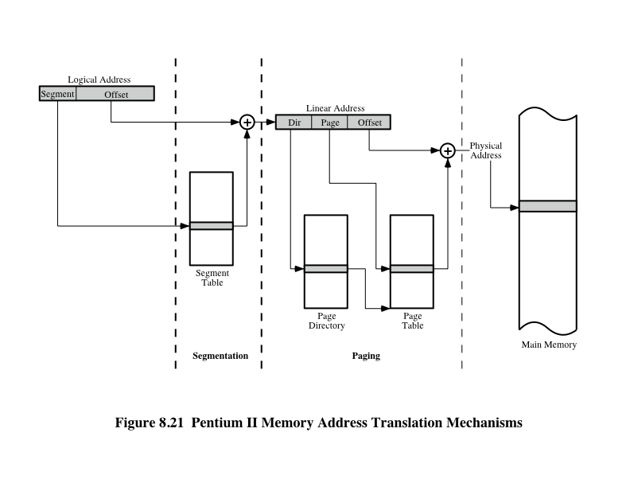
Pentium II Address Translation Mechanism
Notes:
Figure 8.21 illustrates the combination of segmentation and paging mechanisms.
For clarity, the translation lookaside buffer and memory cache mechanisms
are not shown.
Finally, the Pentium II includes a new extension not found on the 80386 or
80486, the provision for two page sizes. If the PSE (page size extension) bit in control
register 4 is set to 1, then the paging unit permits the OS programmer to define
a page as either 4 Kbyte or 4 Mbyte in size.
When 4-Mbyte pages are used, there is only one level of table lookup for
pages. When the hardware accesses the page directory, the page directory entry
(Figure 8.20d) has the PS bit set to 1. In this case, bits 9 through 21 are ignored and
bits 22 through 31 define the base address for a 4-Mbyte page in memory. Thus,
there is a single page table.
The use of 4-Mbyte pages reduces the memory-management storage
requirements for large main memories. With 4-Kbyte pages, a full 4-Gbyte
main memory requires about 4 Mbytes of memory just for the page tables. With
4-Mbyte pages, a single table, 4 Kbytes in length, is sufficient for page memory
management.

Slide 45
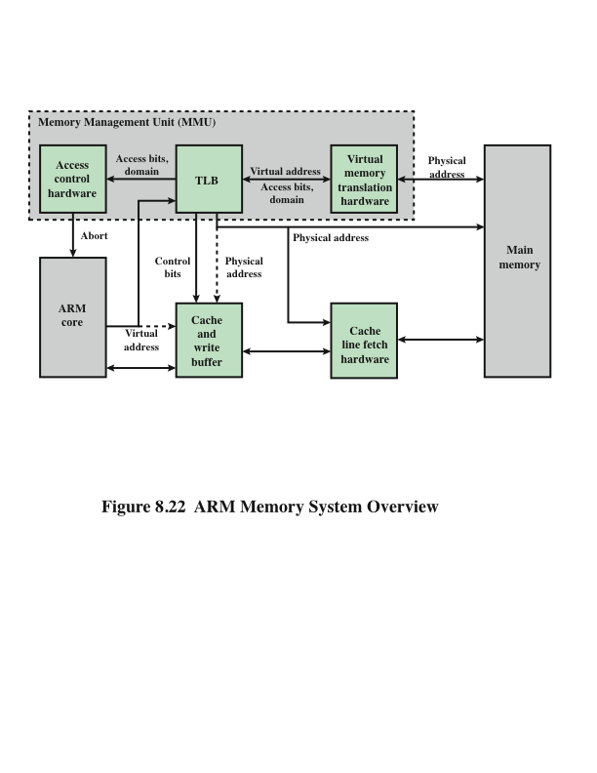
ARM Memory System Overview
Notes:
Figure 8.22 provides an overview of the memory management hardware in the
ARM for virtual memory. The virtual memory translation hardware uses one or
two levels of tables for translation from virtual to physical addresses, as explained
subsequently. The translation lookaside buffer (TLB) is a cache of recent page table
entries. If an entry is available in the TLB, then the TLB directly sends a physical
address to main memory for a read or write operation. As explained in Chapter 4,
data is exchanged between the processor and main memory via the cache. If a logical
cache organization is used (Figure 4.7a), then the ARM supplies that address
directly to the cache as well as supplying it to the TLB when a cache miss occurs. If
a physical cache organization is used (Figure 4.7b), then the TLB must supply the
physical address to the cache.
Entries in the translation tables also include access control bits, which determine
whether a given process may access a given portion of memory. If access is
denied, access control hardware supplies an abort signal to the ARM processor.

Slide 46
Virtual Memory Address Translation
The ARM supports memory access based on either sections or pages
Supersections (optional)
Consist of 16-MB blocks of main memory
Sections
Consist of 1-MB blocks of main memory
Large pages
Consist of 64-kB blocks of main memory
Small pages
Consist of 4-kB blocks of main memory
Sections and supersections are supported to allow mapping of a large region of memory while using only a single entry in the TLB
The translation table held in main memory has two levels:
First-level table
Holds section and supersection translations, and pointers to second-level table
Second-level tables
Hold both large and small page translations
Notes:
The ARM supports memory access based on either sections or pages:
• Supersections (optional): Consist of 16-MB blocks of main memory
• Sections: Consist of 1-MB blocks of main memory
• Large pages: Consist of 64-kB blocks of main memory
• Small pages: Consist of 4-kB blocks of main memory
Sections and supersections are supported to allow mapping of a large region
of memory while using only a single entry in the TLB. Additional access control
mechanisms are extended within small pages to 1kB subpages, and within large
pages to 16kB subpages. The translation table held in main memory has two levels:
• First-level table: Holds section and supersection translations, and pointers to
second-level tables
• Second-level tables: Hold both large and small page translations
The memory-management unit (MMU) translates virtual addresses generated
by the processor into physical addresses to access main memory, and also derives
and checks the access permission. Translations occur as the result of a TLB miss,
and start with a first-level fetch. A section-mapped access only requires a first-level
fetch, whereas a page-mapped access also requires a second-level fetch.

Slide 47
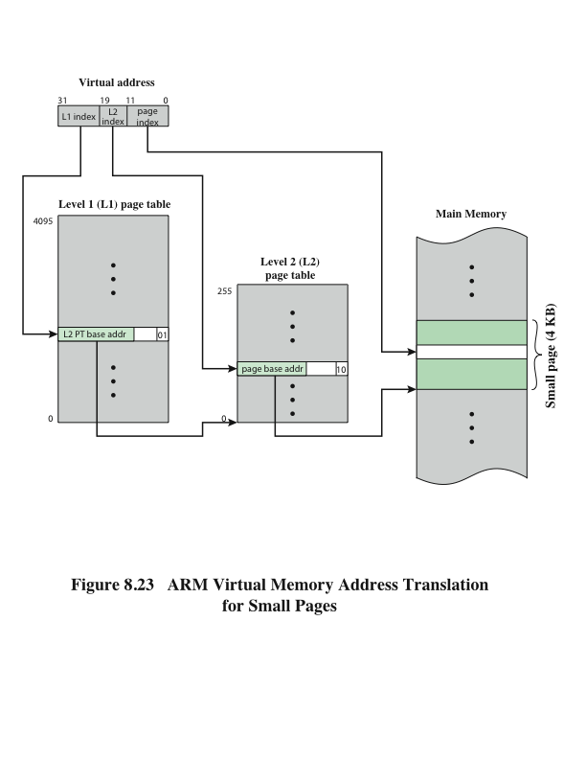
ARM Virtual Memory Address Translation for Small Pages
Notes:
Figure 8.23 shows the two-level address translation process for small pages.
There is a single level 1 (L1) page table with 4K 32-bit entries. Each L1 entry points
to a level 2 (L2) page table with 255 32-bit entries. Each of the L2 entry points to a
4-kB page in main memory. The 32-bit virtual address is interpreted as follows: The
most significant 12 bits are an index into the L1 page table. The next 8 bits are an
index into the relevant L2 page table. The least significant 12 bits index a byte in the
relevant page in main memory.
A similar two-page lookup procedure is used for large pages. For sections and
supersection, only the L1 page table lookup is required.

Slide 48
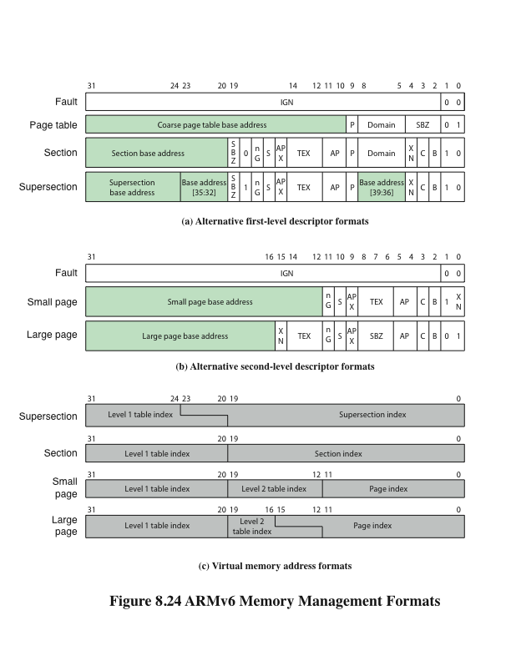
ARMv6 Memory Management Formats
Notes:
To get a better understanding of the ARM memory management scheme, we consider
the key formats, as shown in Figure 8.24. The control bits shown in this figure
are defined in Table 8.6.

Slide 49
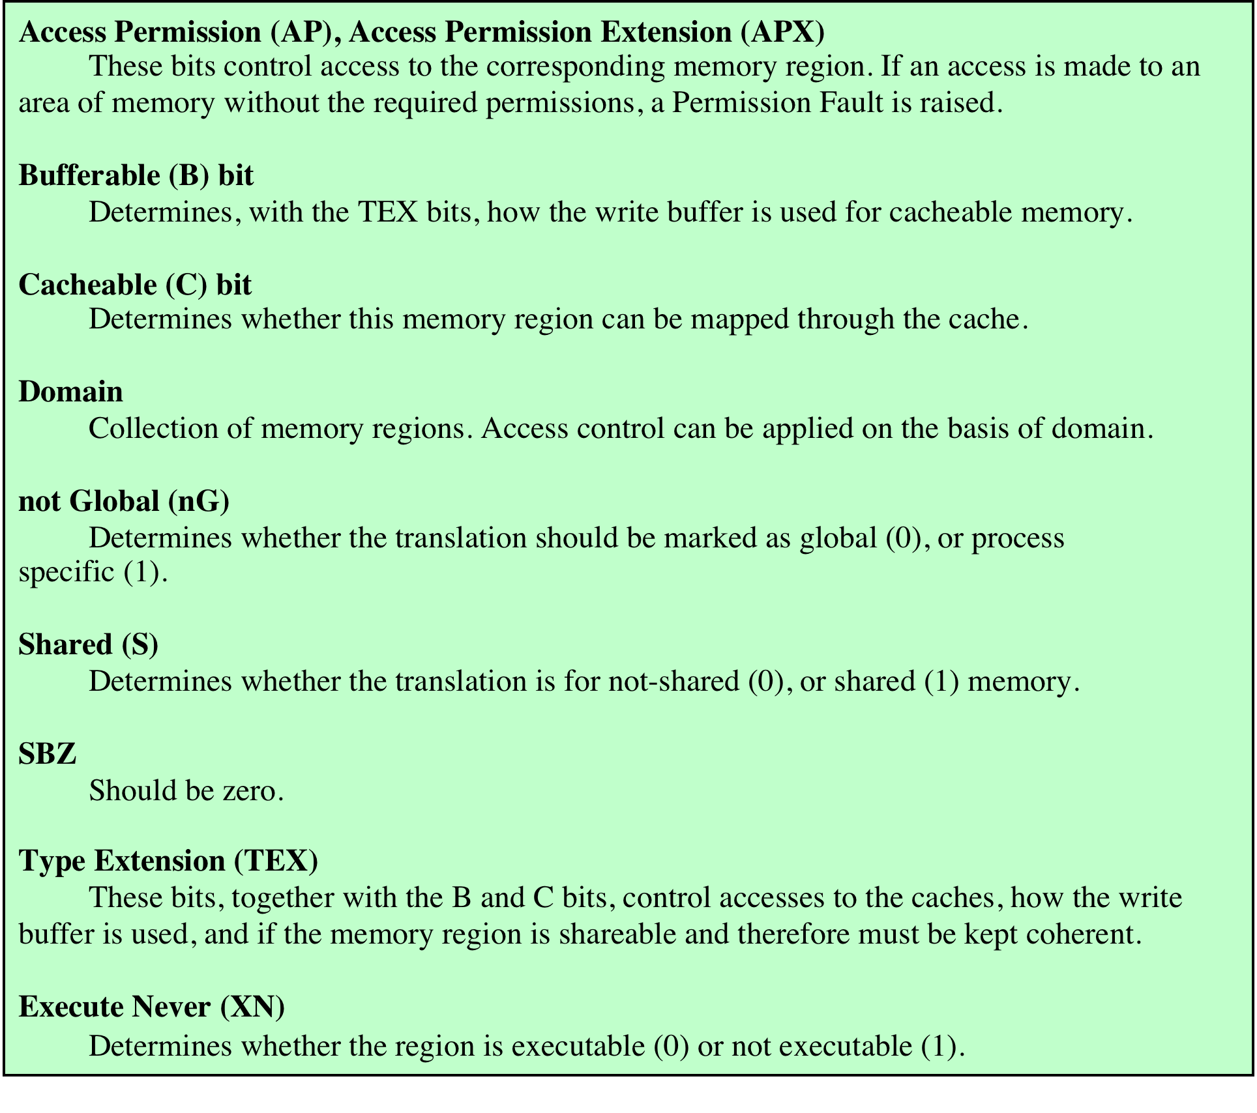
ARM Virtual Memory Address Translation for Small Pages
Table 8.6 ARM Memory-Management Parameters
Notes:
Table 8.6 ARM Memory Management Parameters

Slide 50
Access Control
The AP access control bits in each table entry control access to a region of memory by a given process
A region of memory can be designated as:
No access
Read only
Read-write
The region can be privileged access only, reserved for use by the OS and not by applications
ARM employs the concept of a domain:
collection of sections and/or pages that have particular access permissions
The ARM architecture supports 16 domains
Allows multiple processes to use the same translation tables while maintaining some protection from each other
Two kinds of domain access are supported:
Clients
Users of domains that must observe the access permissions of the individual sections and/or pages that make up that domain
Managers
Control the behavior of the domain and bypass the access permissions for table entries in that domain
Notes:
The AP access control bits in each table entry control access to a region of memory
by a given process. A region of memory can be designated as no access, read
only, or read-write. Further, the region can be designated as privileged access only,
reserved for use by the OS and not by applications.
ARM also employs the concept of a domain, which is a collection of sections
and/or pages that have particular access permissions. The ARM architecture supports
16 domains. The domain feature allows multiple processes to use the same
translation tables while maintaining some protection from each other.
Each page table entry and TLB entry contains a field that specifies which
domain the entry is in. A 2-bit field in the Domain Access Control Register controls
access to each domain. Each field allows the access to an entire domain to be enabled
and disabled very quickly, so that whole memory areas can be swapped in and
out of virtual memory very efficiently. Two kinds of domain access are supported:
• Clients: Users of domains (execute programs and access data) that must
observe the access permissions of the individual sections and/or pages that
make up that domain
• Managers: Control the behavior of the domain (the current sections and pages
in the domain, and the domain access), and bypass the access permissions for
table entries in that domain
One program can be a client of some domains, and a manager of some other
domains, and have no access to the remaining domains. This allows very flexible
memory protection for programs that access different memory resources.

Slide 51
Summary
Operating System
Support
Chapter 8
Memory management
Swapping
Partitioning
Paging
Virtual memory
Translation lookaside buffer
Segmentation
ARM memory management
Memory system organization
Virtual memory address translation
Memory-management formats
Access control
Operating system objectives and functions
Types of operating systems
Scheduling
Long-term scheduling
Medium-term scheduling
Short-term scheduling
Pentium memory management
Address spaces
Segmentation
Paging
Notes:
Chapter 8 summary.

